Slide 1

2021-2022 SPRING SEMESTER
EE464 Term Project

Slide 2
Complete Simulation Report POWER CONVERTERS EMRE ÇELEN 2594430 ANIL YALÇINKAYA 2376085 UĞUR CEM ERDEM 2231876

Slide 3
Project Specifications
Minimum Input Voltage : 24 V
Maximum Input Voltage : 48 V
Output Voltage : 15 V
Output Power : 45 W
Output Voltage Peak-to-Peak Ripple : 3%
Line Regulation (Deviation of percent output voltage when input voltage is changed from its minimum to maximum or vice versa) : 3%
Load Regulation (Deviation of percent output voltage when load current is changed from 10% to 100% or vice versa) : 3%

Slide 4
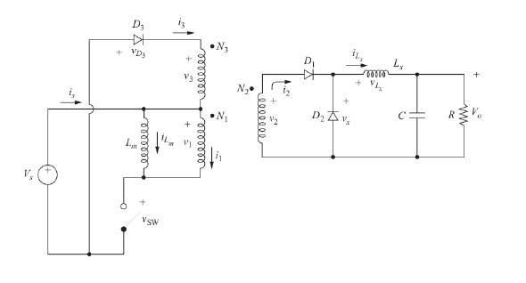
Topology Selection
FORWARD CONVERTER

Slide 5
Advantages of Forward Converter Topology
Instead of storing it in the transformer first, the energy can be sent directly over to the load.
The output inductor and diode ensures continuous output current. So, the capacitor size can be reduced.

Slide 6
Disadvantages of Forward Converter Topology
Cost is high (extra diode, inductor and extra winding)
MOSFET requires a higher voltage (Stress on the switch)

Slide 7
Advantages of Push-Pull Converter Topology
Center-tapped topology is used.
The waveforms are repeated every Ts/2.
The current ripples are smaller.
Switching frequency is doubled.
Utilization of the magnetic core is better (By looking B-H characteristics) .
So, a smaller magnetic core can be used to transfer the same amount of energy.

Slide 8
Disadvantages of Push-Pull Converter Topology
Cost is high (two switch)
Control mechanism is more complex because of the two switches

Slide 9
Advantages of Flyback Converter Topology
There is no need to use output inductance.
(However,oscillating output current exists)
The energy is stored in the transformer.
So, this converter is implemented simply.
Cheap (fewer components)
Easy to control (Single switch)

Slide 10
Team Choice
Our output power requirement is less than 100W
Fewer component
Magnetic design is more simpler
FLYBACK CONVERTER TOPOLOGY is chosen.

Slide 11
Operating Mode
Continuous-conduction-mode (CCM) means that the current in the energy transfer inductor or transformer never goes to zero between switching cycles.
In discontinuous-conduction-mode (DCM) the current goes to zero during part of the switching cycle

Slide 12
DCM Advantages
Lower primary inductance than CCM
Inductance sets the maximum duty cycle
Smaller transformer possible
No rectifier reverse,recovery losses
No (or minimal) FET turn-on losses
No right half-plane zero in the control loop
Optimal for low output power

Slide 13
DCM Disadvantages
Higher peak primary current
Higher peak rectifier current
Increased input capacitance
Increased output capacitance
Potentially increased electromagnetic interference
Wider duty-cycle operation than CCM
Increased bandwidth variation

Slide 14
Team Choice for Operating Mode
The mode we decided to use as a group is quasi resonant
This means our flyback converter is exactly on the DCM and CCM boundary.
In this way, the efficiency will be increased.

Slide 15
Advantages of Quasi Resonant Mode
It will offer lower switching losses
It can handle multiple outputs
Wide input range
Easier to compensate

Slide 16
Drawbacks of Quasi Resonant Mode
It may require a higher capacitance in the output as it is operating in the DCM region.
Not usually recommended for applications more than 100 Watts.

Slide 17
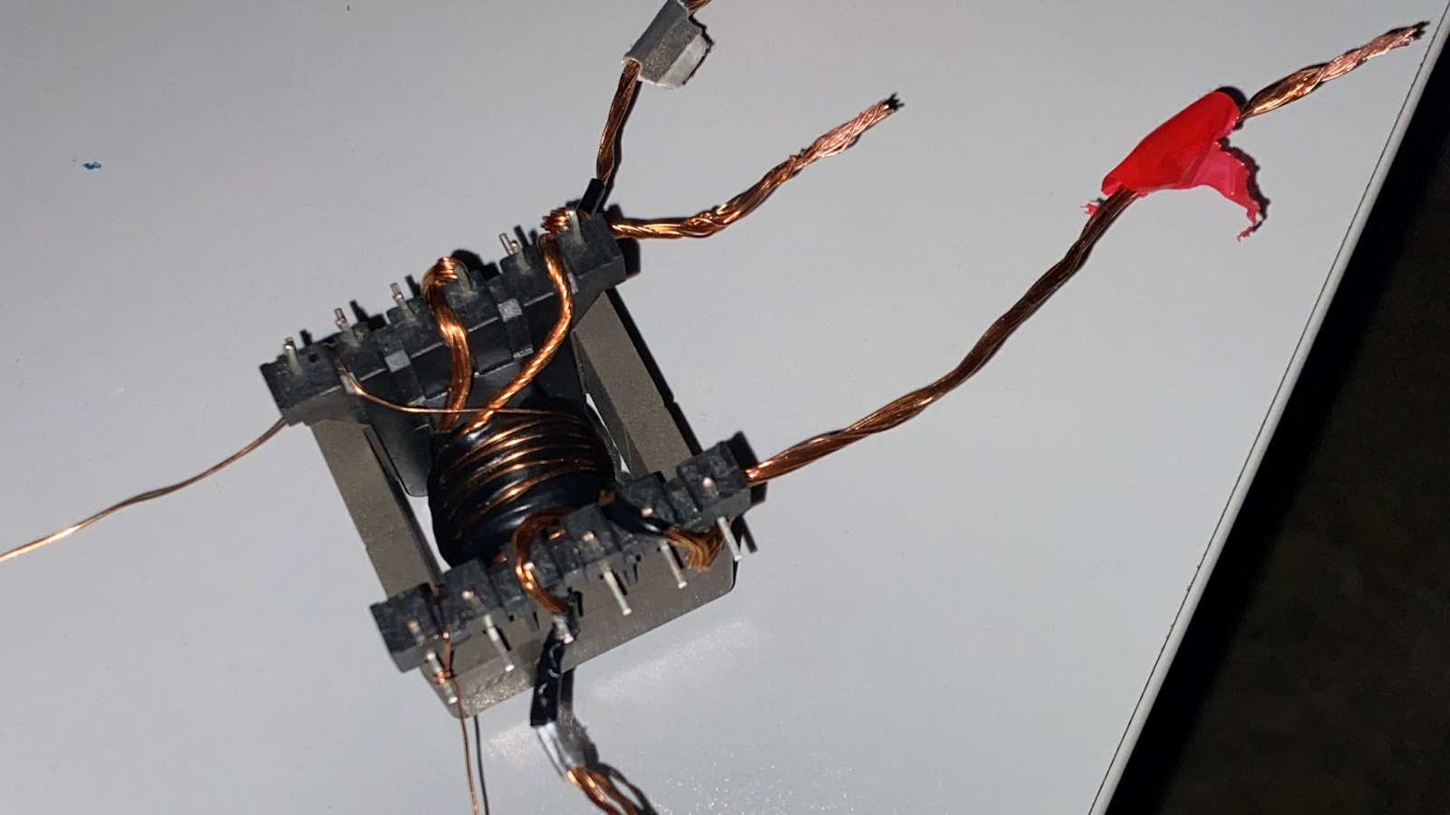
Our Transformer

Slide 18
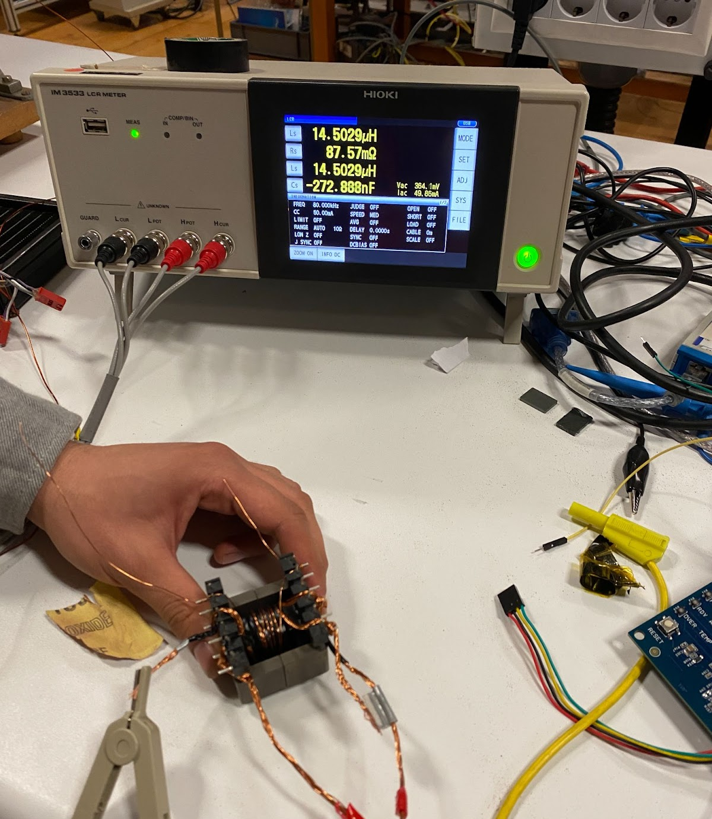
LCR Test : Magnetizing Inductance and 80kHz AC resistance of primary winding
Lm : 14.5 uH
R : 87.57 m Ω

Slide 19
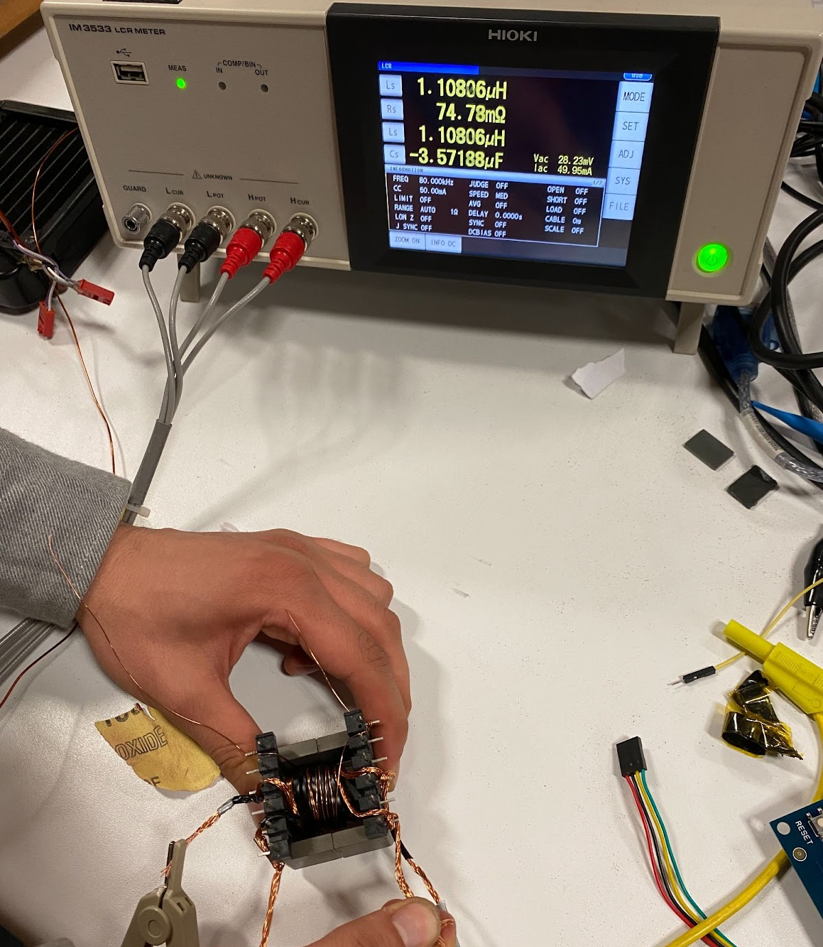
LCR Test: Leakage Inductance
L : 1.108 uH

Slide 20
LCR Test : Inductance and 80kHz AC Resistance of Secondary Winding
L : 7.549 uH
R : 51.77 m Ω

Slide 21
LCR Test : 10 Hz AC Resistance of Primary Winding
R : 13.01 m Ω

